Slide 1
Heterogeneous Graph Transformer
Ziniu Hu¹, Yuxiao Dong², Kuansan Wang², Yizhou Sun¹
¹University of California, Los Angeles
²Microsoft Research, Redmond

Slide 2
Outline
Introduction to Heterogeneous Graph (HG)
Traditional HG Inference: Metapaths
Designing Graph Neural Networks for HG
Pre-Training Graph Neural Networks for HG

Slide 3
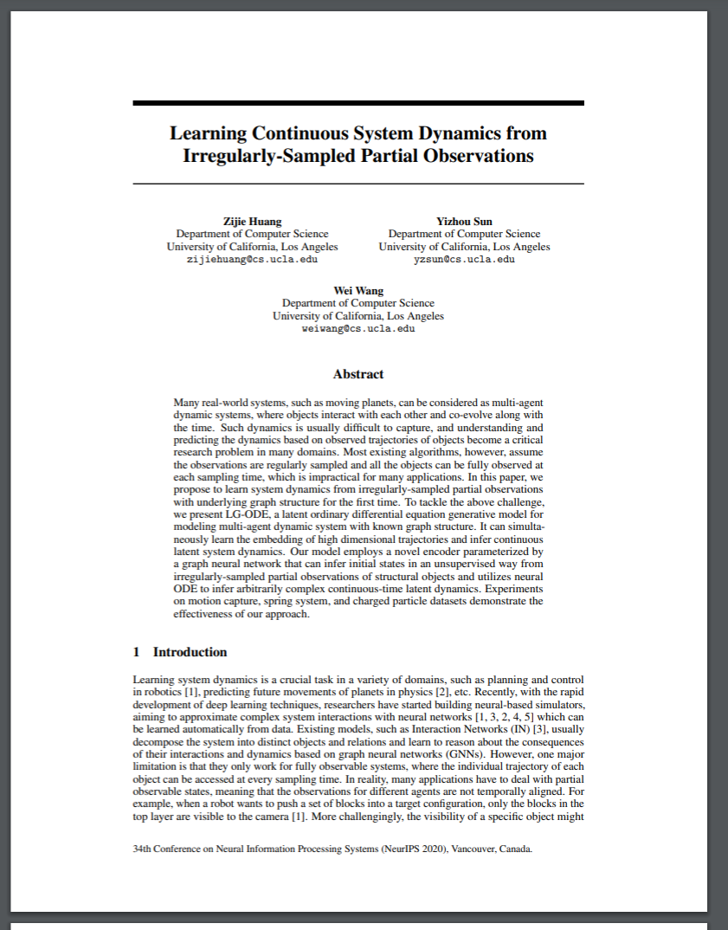
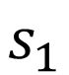
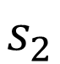
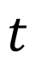
Heterogeneous (Relational) Graph
Heterogeneous graphs can model complex systems
Nodes are labeled with multiple types
Edges between nodes have multiple relationships
It’s flexible to capture rich semantic knowledge.
Paper
$$t$$
Write
Cite
$$s_{1}$$
$$s_{2}$$
Author
Paper
Notes:
Heterogeneous graphs, or so-called relational graph, is a special type of graph, in which their nodes and edges are associated with a specific type.
For example, in this simple network example, a target paper is associated with a author node and another paper nodes, with corresponding relationships, denoting the author write thie paper, and cite another paper.
Heterogeneous graphs can model complex systems, and it’s flexible to capture rich semantic knowledge.

Slide 4
Heterogeneous (Relational) Graph
Heterogeneous graphs can model complex systems
Nodes are labeled with multiple types
Edges between nodes have multiple relationships
It’s flexible to capture rich semantic knowledge.
Node Type
Paper
$$t$$
Write
Cite
$$s_{1}$$
$$s_{2}$$
Author
Paper
Notes:
Here, the paper is the node type

Slide 5
Heterogeneous (Relational) Graph
Heterogeneous graphs can model complex systems
Nodes are labeled with multiple types
Edges between nodes have multiple relationships
It’s flexible to capture rich semantic knowledge.
Paper
$$t$$
Edge (Relation) Type
Write
Cite
$$s_{1}$$
$$s_{2}$$
Author
Paper
Notes:
Write is the edge, or relation type

Slide 6
Heterogeneous (Relational) Graph
Heterogeneous graphs can model complex systems
Nodes are labeled with multiple types
Edges between nodes have multiple relationships
It’s flexible to capture rich semantic knowledge.
Paper
$$t$$
Write
Cite
Node Feature
$$s_{1}$$
$$s_{2}$$
Author
Paper
Notes:
And the text is the node feature for this paper node.
For the author node, it can be associated with totally different features, such as the author profile table or even image.

Slide 7
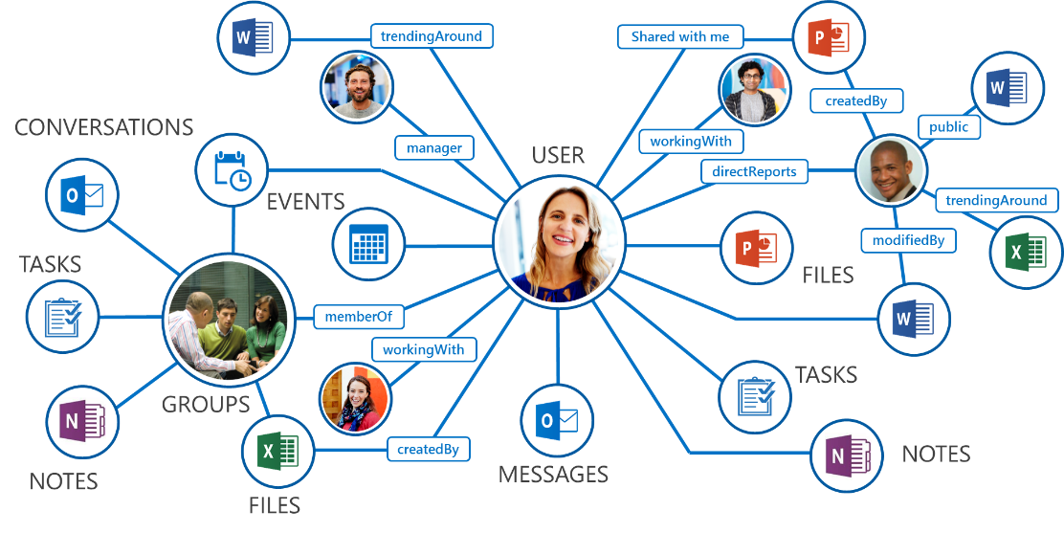
Example: Microsoft Office Graph
Node Types: Emails, Files, Tasks, Notes, Messages, ……
Relation Types: share, working, created, modified, memberOf, schedule, ……
Notes:
To give a more vivid view, I give several real-world heterogeneous graph as examples.
This is the Microsoft Office Graph, in which we have multiple node types including emails, files, tasks, notes, messages, etc.
Also, different pairs of nodes are connected by differenty types of edges. For example, user can share files, created files, schedule meetings, etc.

Slide 8
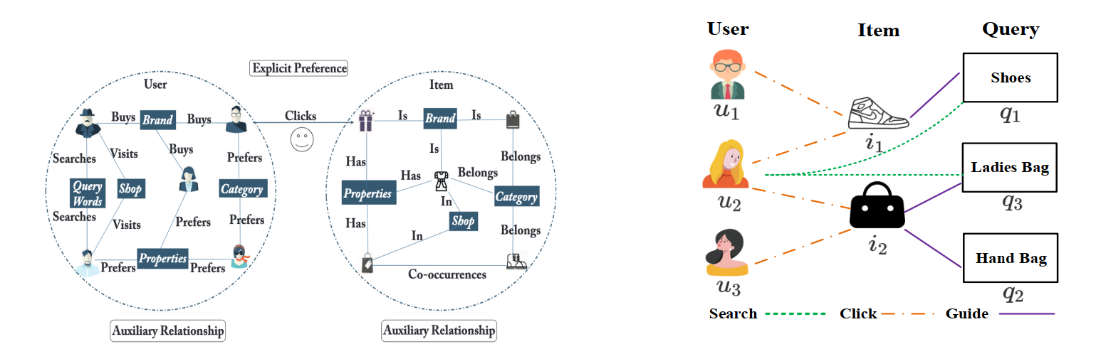
Example: E-Commerce & Recommendation
Node Types: User, Item, Query, Attribute, Location, ……
Relation Types: Buy, Prefer, Visit, Search, Click, Belong, Is, Co-occur, ……
Notes:
Also, the e-commerce user behaviour can also be abstracted as a heterogeneous graph, in which there are nodes like user, item, query, attribute, location, etc. The edge between user and item can be diverse, including buy, prefer, visit, search, click, etc. And among items, there are relations like belong, co-occur.

Slide 9

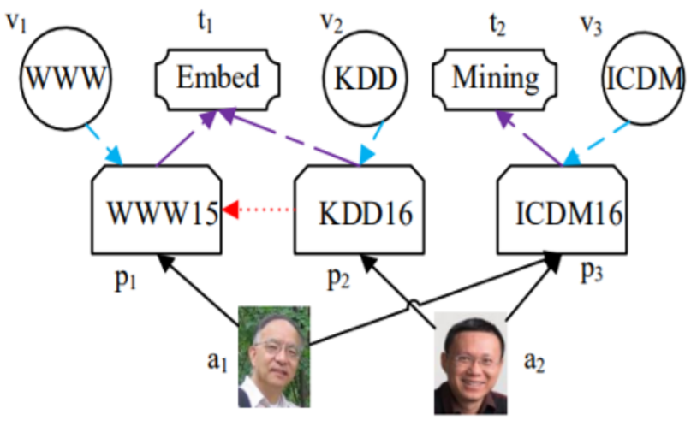





Example: Academic Graphs
Node Types: paper, author, venue, institutions, fields.
Relation Types: pubYear, Author-ship, citation, ……
711,012
fields of study
48,859 journals
4,457 conferences
233 million papers/patents/books/preprints
239 million authors
25,564 Institutions
Notes:
Finally, we introduce academic graphs.
This is the heterogeneous graph that represents how the scholars publish research articles.
The node types are paper, author, venue, institutes and fields (which is paper topic)

Slide 10
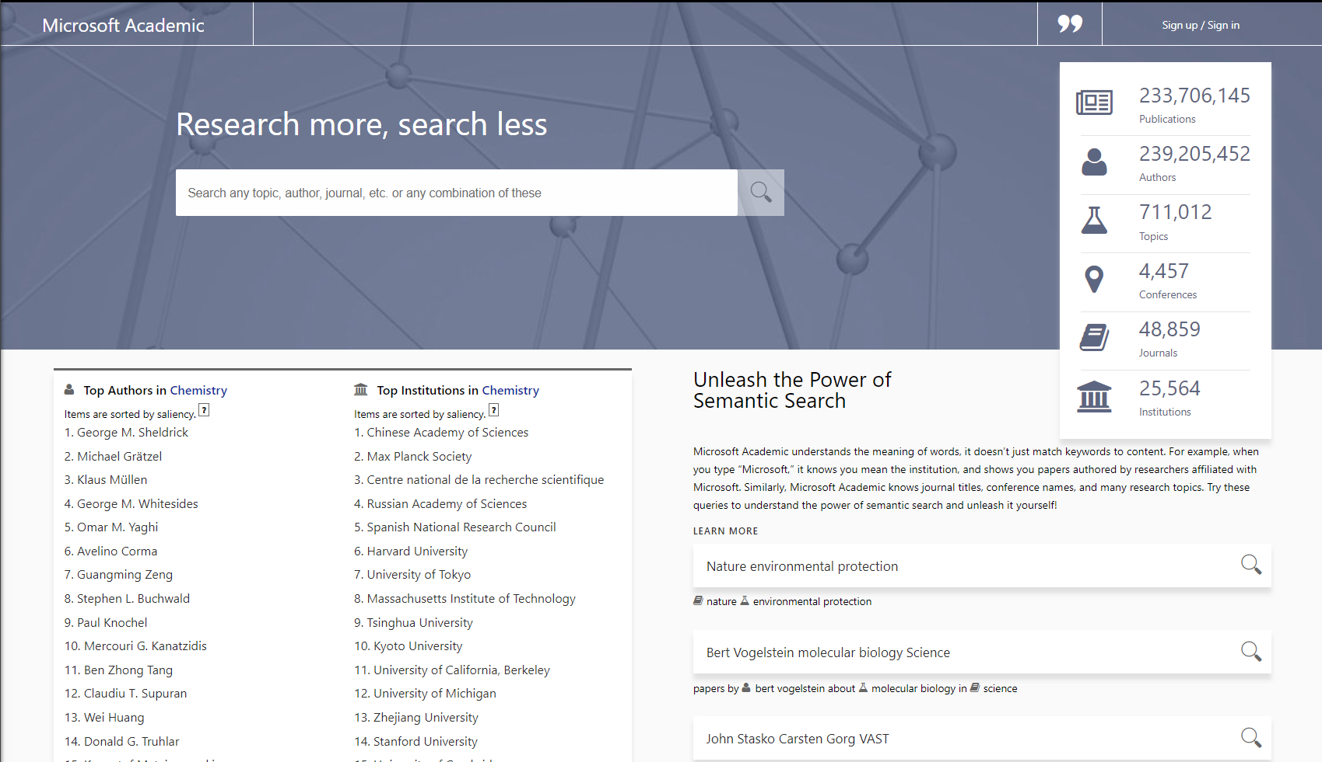
https://academic.microsoft.com
Notes:
The Microsoft Academic Graph is one of the largest heterogeneous academic graph, and implements a lot of online services to support academic research and analysis.
In the following, I’ll briefly introduce some of its features, and let us know what are the major tasks in the whole heterogeneous graph research.

Slide 11
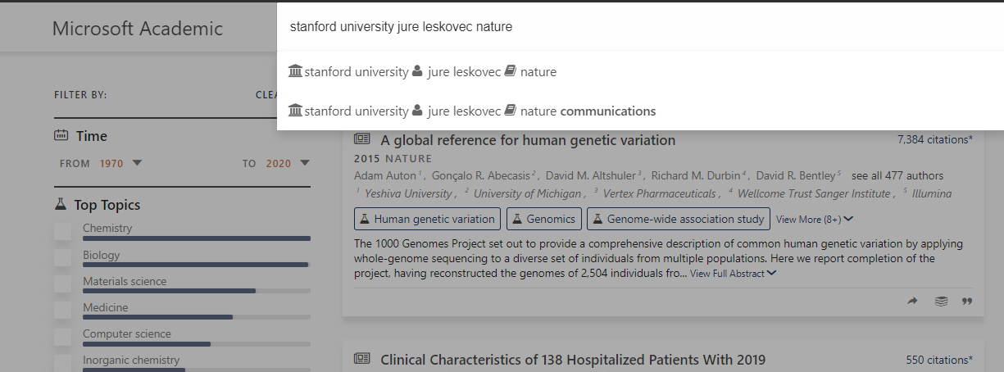
Entity Recognition
Notes:
First is entity recognition.
Given a search query, we need to associate it to the correct node in the network, and the nodes can be from totally different types.
For example, in this query, the system successfully segments and identify the institution node Stanford, Author node Jure, and Venue node Nature.
This task require the model to get accurate representation for the nodes in heterogeneous graph

Slide 12
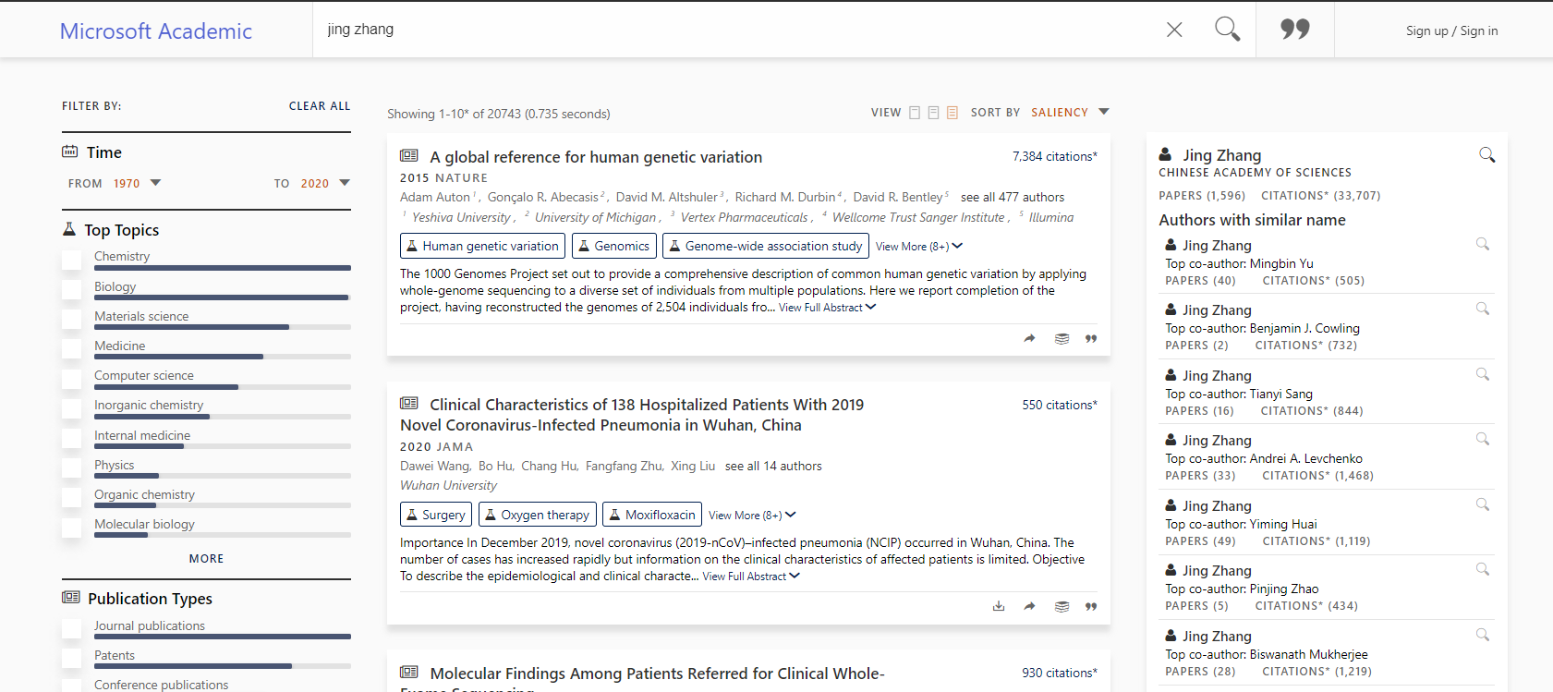
Name Disambiguation
Notes:
Another challenging task is name disambiguation.
Since there are many scholars sharing the same name, it’s required to distuinsh them based on their publication records.

Slide 13
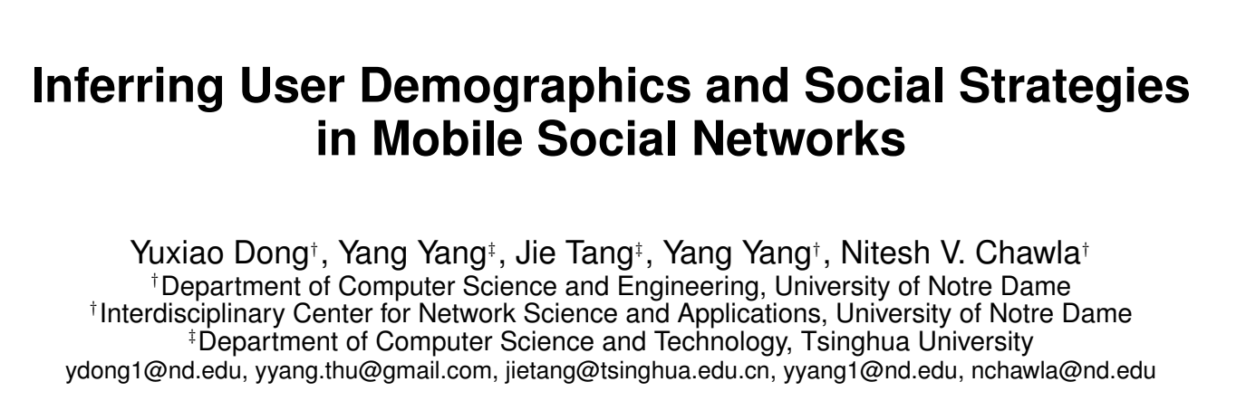
Name Disambiguation
Notes:
In online service, Name disambiguation is used to identify which author node is the true author node.

Slide 14

Inferring Fields of Study (Topic)
Notes:
Another interesting task is to predict which topic a paper belongs to.
MAG can automatically group and summarize some important topic into the field nodes, and for each new paper, it will infer which topic it belongs to by the heterogeneous graph.

Slide 15
Reasoning about COVID-19 from MAG
SARS-CoV-2
Wasting
Oseltamivir
Diarrhea
Asymptomatic
Lamivudine
Coronavirus
Azithromycin
COVID-19
MERS
Antiviral drug
Zika Virus
Rash
Post-exposure prophylaxis
Ebola Virus
Abdominal pain
Cause
Symptom
Treatment
Notes:
Also, as we can have good representation of these nodes, we can construct a taxonomy of fields, and even conduct some reasoning task on top of it for some specific task.
For example, if we wants to know the topic entities related to COVID-19, we can retrieve three clusters of topics, belonging to cause, symptom and treatment separately.

Slide 16
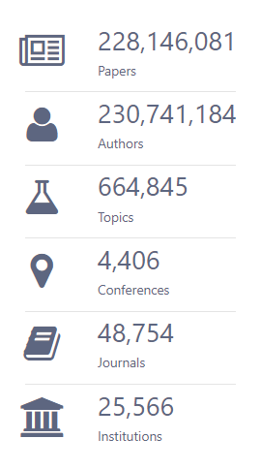
Data and Tasks in Microsoft Academic Graph
Data Tasks
Name disambiguation
Infer spam/fake papers
Infer paper/author research topics
Infer future scientific impact
Infer collaboration and team formation
Infer future paper title?
… …
Notes:
To summarize, MAG is a very large-scale and diverse heterogenous graph, which contains about half billion nodes and 10 billion edges.
It also has diverse down-stream tasks that could be evaluated.
Therefore, how to model such a network poses great challenge for research.

Slide 17
Outline
Introduction to Heterogeneous Graph (HG)
Traditional HG Inference: Metapaths
Designing Graph Neural Networks for HG
Pre-Training Graph Neural Networks for HG
Notes:
Before we introduce the HGT paper, let me introduce one of the most classical and effective approach to model and infer HG, which is metapath.

Slide 18
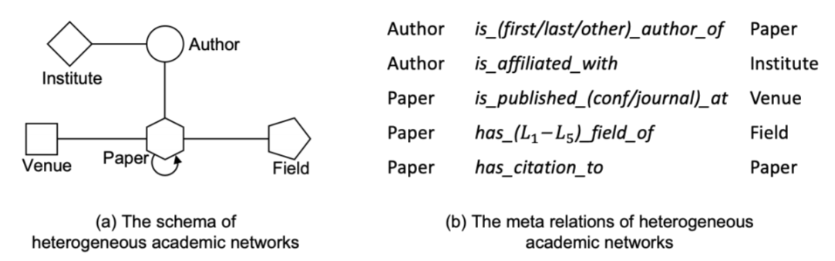
Meta Relation Schema
Heterogeneous graph schema is high-level description of a graph semantic
For an edge e = (s, t) linked from source node s to target node t, its meta relation is denoted as ⟨τ (s),ϕ(e), τ (t)⟩.
Example: Academic Graph have the following schema:
Notes:
We firstly introduce a meta relation schema, which is a high-level description of a heterogenous graph semantic.
For an edge e = (s, t) linked from source node s to target node t, its meta relation is denoted as ⟨τ (s),ϕ(e), τ (t)⟩.
For example, the MAG has the following schema, where the author and paper can be connected by different authorshiops, paper and venue can be connected by conf/journal, paper and field can be connected by different level.

Slide 19
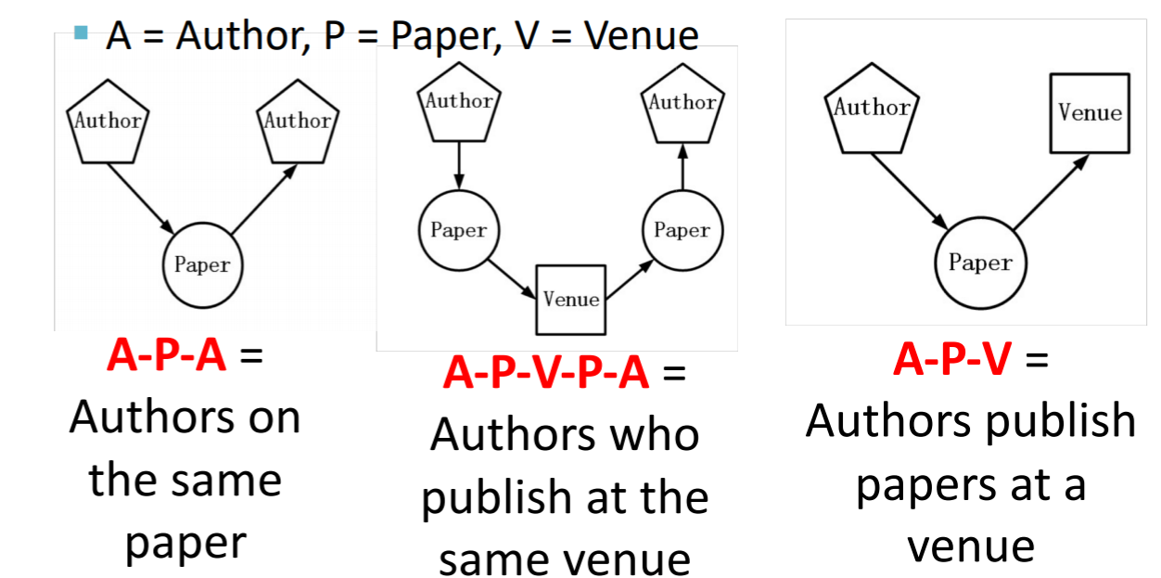
Metapaths
For an edge e = (s, t) linked from source node s to target node t, its meta relation is denoted as ⟨τ (s),ϕ(e), τ (t)⟩.
Metapaths are is defined as a sequence of such meta relation
Notes:
Metapaths are is defined as a sequence of such meta relation
For example, A-P-A is the authors on the same paper, A-P-V is authors that publish papers at a particular venue.
Metapathes denote a composition of relations. Utilizing metapaths, we can estimate the similarity of some nodes. For example, given A-P-A metapath, we can model the co-authorship of two authors.

Slide 20
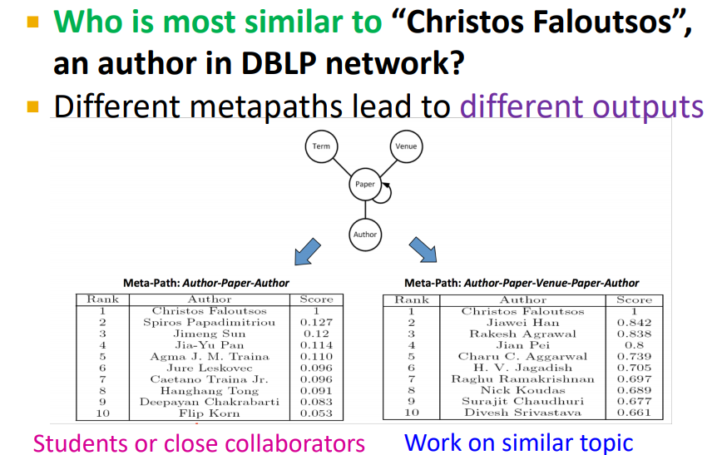
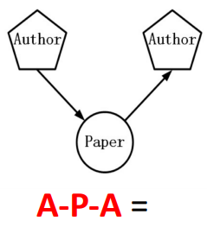
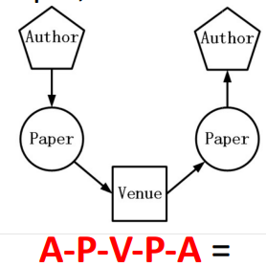
Notes:
Usint metapths we can estimate the node similarity on the graph.
However, picking the correct path for a particular task is a non-trivial thing, as different metapaths lead to totally different outputs.
For example, when we ask who is most similar to Christos Fgaloutos, using the first metapath A-P-A we focus on the co-authorships, so most likely we get his students or clos collaborators.
However, if we use A-P-V-P-A, which focus on authors publishing papers on the same venue, we most likely will get the other data mining researchers that work on similar works.

Slide 21
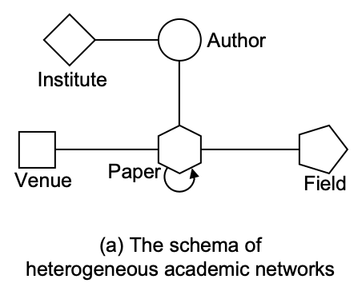
Heterogeneous Graph Mining
Classification
RankClass, …
Clustering
RankClus, …
Ranking
PathSim, …
Link Prediction
PathPredict, …
…
meta paths
Yizhou Sun, Jiawei Han. Mining Heterogeneous Information Networks: Principles and Methodologies. M & C Publishers, 2012.
Notes:
To sum up, metapath is a useful tool to mine a specific property of the heterogeneous graph, and different task might require different meta paths, which traditionally are designed by the researchers.

Slide 22
Heterogeneous Graph Representation Learning
Classification
Clustering
Ranking
Link Prediction
…
graph
representation
learning
meta paths
heter. graph representation learning
metapath2vec, PTE, …
R-GCN, HetGNN, GEM, …
Notes:
When we come to deep learning days, people wants to represent the nodes and data into continuous space, and learn the representation by a objective in an end-to-end manner.
For heterogenous graphs, there emerges a plenty of works that combine meta paths with graph representation learning methods, such as R-GCN and HetGNN.

Slide 23
Heterogeneous Graph Representation Learning
Can we automatically learn meta paths?
Classification
Clustering
Ranking
Link Prediction
…
meta paths
(feature
engineering)
graph
representation
learning
heter. graph representation learning
metapath2vec, PTE, …
R-GCN, HetGNN, GEM, …
Notes:
However, they still need to manually decide which meta paths to turn the graph into homogenous one, and then adopt standard GNN to handle it.
Is there a way that we can automatically learn the meta paths on-the-fly, and also capture the rich semantic of the graph into model design?

Slide 24
Outline
Introduction to Heterogeneous Graph (HG)
Traditional HG Inference: Metapaths
Designing Graph Neural Networks for HG
Pre-Training Graph Neural Networks for HG

Slide 25
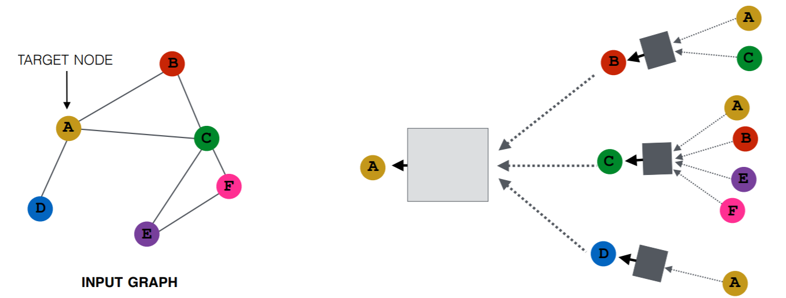
Graph Neural Networks (GNNs)
Key Idea: Each node aggregates messages from its neighborhood to get contextualized node embedding.
Limitation: Most GNNs focus on homogeneous graph.
Aggregate neighbor’s information
Neural Transformation
Notes:
GNN aggregates messages from its neighborhood to get contextualized node embedding, and learn the ewight matrices on-the-fly.
Most GNN only focus on homogeneous graph where nodes belong to same type.

Slide 26
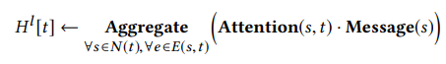
Attention-based GNN Framework
Attention: importance of each source node
Message: output of souce node s.
Aggregate: sum the messages by attention weights.
Notes:
Before we introduce our own model, I give a simple formula framwrok to represent different attention-based GNN models.
We require Attention: importance of each source node
Message: output of souce node s.
Aggregate: sum the messages by attention weights.

Slide 27
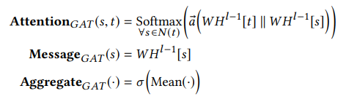
Attention-based GNN Framework
Attention: importance of each source node
Message: output of souce node s.
Aggregate: sum the messages by attention weights.
For example, GAT is:
Notes:
For example, the Graph Attention Network (GAT) [22] adopts an additive mechanism as Attention, uses the same weight for calculating Message, and leverages the simple average followed by a nonlinear activation for the Aggregate step

Slide 28
Challenges for handling heterogeneous graph
Different types of nodes/edges have own feature distribution
Node: Papers have text features, while authors have affiliation features
Edge: Co-authorship is different with citation

Slide 29
Challenges for handling heterogeneous graph
Different types of nodes/edges have own feature distribution
Node: Papers have text features, while authors have affiliation features
Edge: Co-authorship is different with citation
Graph can be dynamic and large-scale
KDD in 1990 is more related to database, but it’s closer to machine learning in recent years
The number of papers doubles every 12 years, and now reaches billion

Slide 30
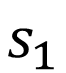
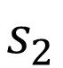
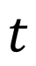
Meta-Relation-based Parametrization
Introduce node- and edge- dependent attention
Leverage meta relation <source node type, edge type, target node type> to parameterize attention and message passing weight.
Can automatically learn and extract meaningful “meta paths”
Paper
$$t$$
W_{<Author, Write, Paper>}
=W_{Author} W_{Write} W_{Paper}
W_{<Paper, Cite, Paper>}
=W_{Paper} W_{Cite} W_{Paper}
Write
Cite
$$s_{1}$$
$$s_{2}$$
Author
Paper

Slide 31
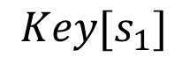
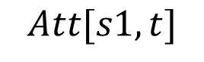
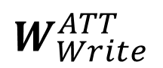
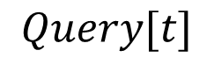
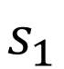
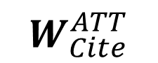
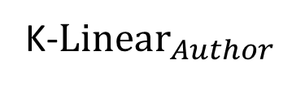
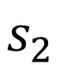
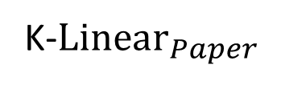
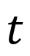
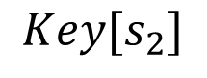
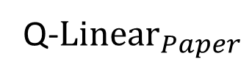
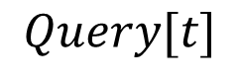
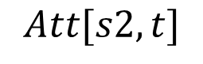
Heterogeneous Mutual Attention
Paper
$$t$$
Q-$Linear_{Paper}$
$$Query[t]$$
Write
Cite
$$Key[s_{1}]$$
$$W_{Cite}^{ATT}$$
$$Att[s1,t]$$
$$s_{2}$$
K-$Linear_{Paper}$
Paper
…
…
$$Query[t]$$
$$s_{1}$$
$$W_{Write}^{ATT}$$
$$Att[s2,t]$$
K-$Linear_{Author}$
$$Key[s_{2}]$$
Author

Slide 32
Target NodeType: Paper
x_{t}
x_{sa}
...
x_{sp}
...
x_{sv}
...
x_{sf}
...
Source NodeType: Author Paper Venue Field
Suppose we want to calculate embedding of target node x_{t}

Slide 33
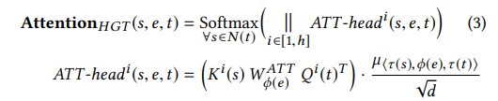
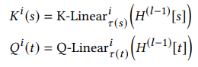
Target NodeType: Paper
x_{t}
WI_{<author, write, paper>}
=Si_{author} RI_{write} TI_{paper}
x_{sa}
...
x_{sp}
...
x_{sv}
...
x_{sf}
...
Source NodeType: Author Paper Venue Field
Step 1: Calculate mutual attention

Slide 34
Target NodeType: Paper
x_{t}
WI_{<author, write, paper>}
=Si_{author} RI_{write} TI_{paper}
WI_{<field, rev_in, paper>}
WI_{<paper, cite, paper>}
WI_{<venue, rev_in, paper>}
x_{sa}
...
x_{sp}
...
x_{sv}
...
x_{sf}
...
Source NodeType: Author Paper Venue Field
Step 1: Calculate mutual attention

Slide 35
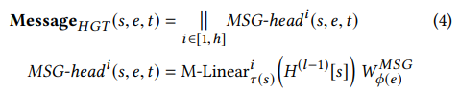
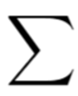
Target NodeType: Paper
x_{t}
WI_{<author, write, paper>}
=Si_{author} RI_{write} TI_{paper}
WI_{<field, rev_in, paper>}
WI_{<paper, cite, paper>}
WI_{<venue, rev_in, paper>}
x_{sa}
...
x_{sp}
...
x_{sv}
...
x_{sf}
...
Source NodeType: Author Paper Venue Field
WP_{<author, write, paper>}
=SP_{author} RP_{write} TP_{paper}
Step 2: Propagation:
Propagate feature from source to target (with different types)

Slide 36
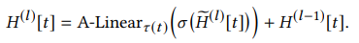
Target NodeType: Paper
x_{t}
WI_{<author, write, paper>}
=Si_{author} RI_{write} TI_{paper}
WI_{<field, rev_in, paper>}
WI_{<paper, cite, paper>}
WI_{<venue, rev_in, paper>}
x_{sa}
...
x_{sp}
...
x_{sv}
...
x_{sf}
...
Source NodeType: Author Paper Venue Field
WP_{<author, write, paper>}
=SP_{author} RP_{write} TP_{paper}
Step 2: Propagation:
Propagate feature from source to target (with different types)

Slide 37
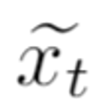
Target NodeType: Paper
x_{t}
WI_{<author, write, paper>}
=Si_{author} RI_{write} TI_{paper}
WI_{<field, rev_in, paper>}
WI_{<paper, cite, paper>}
WI_{<venue, rev_in, paper>}
x_{sa}
...
x_{sp}
...
x_{sv}
...
x_{sf}
...
Source NodeType: Author Paper Venue Field
WP_{<paper, cite, paper>}
WP_{<venue, rev_in, paper>}
WP_{<author, write, paper>}
=SP_{author} RP_{write} TP_{paper}
WP_{<field, rev_in, paper>}
Step 2: Propagation:
Propagate feature from source to target (with different types)
WO_{paper}

Slide 38
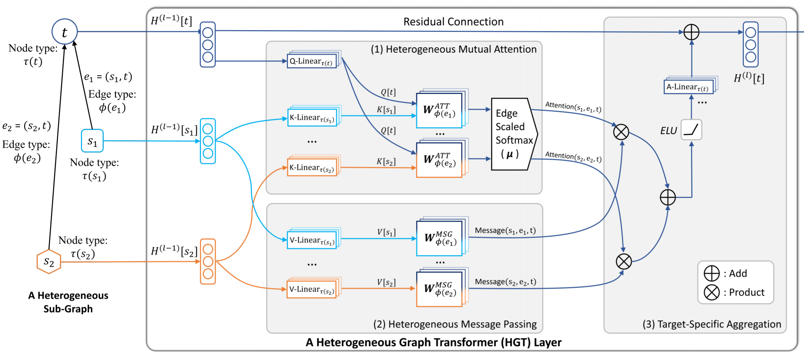
Heterogeneous Graph Transformer

Slide 39
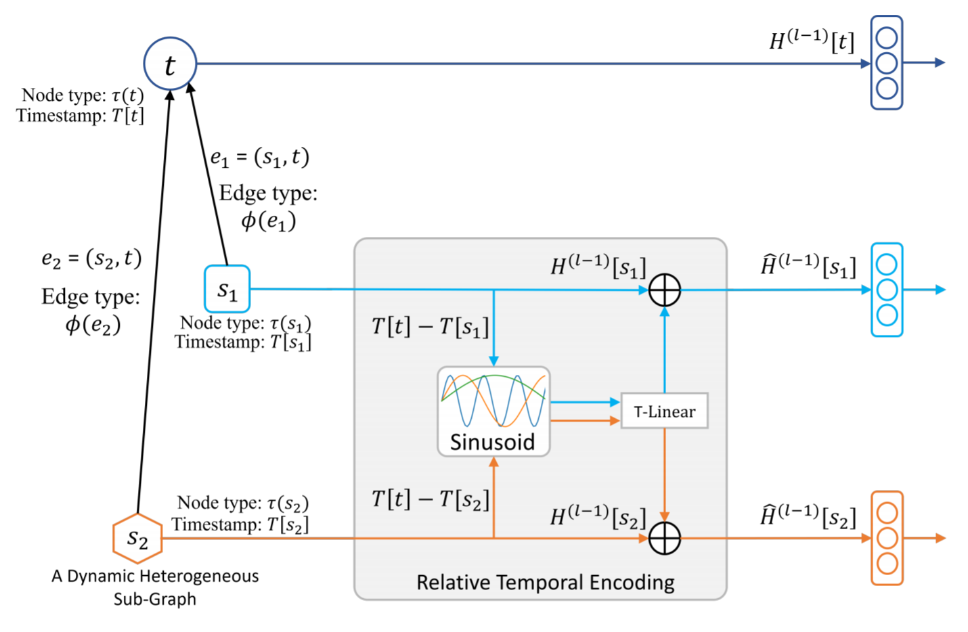
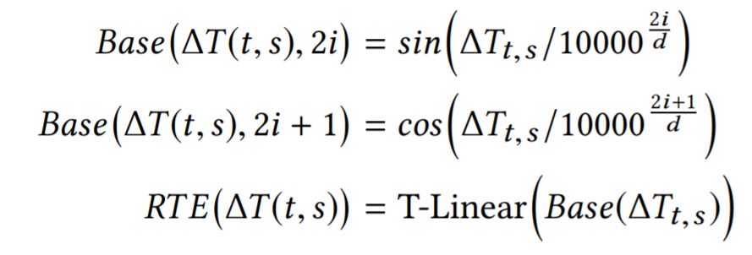
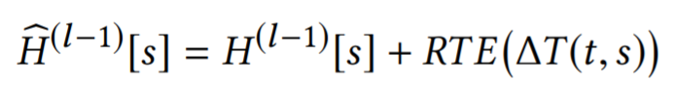
Relative Temporal Encoding
To handle graph dynamics:
Instead of slicing the input graph into different timestamp
We propose to maintain all edges in different times and adopt RTE to encode time.

Slide 40
How we assign timestamps for each node
In Academic Graph, only Paper (Events) contain temporal information.
Other nodes should be represented differently based on different paper:
E.g. KDD@2000 is very different from KDD@2019

Slide 41
How we assign timestamps for each node
We assign timestamps by recursively inherent from paper node
If there exist multiple papers in different timestamps linked to a same node, we will separate that node and assign different timestamps
Published at 2012
Paper 1
DM
Author
Published at 2018
KDD
Paper 2

Slide 42
How we assign timestamps for each node
We assign timestamps by recursively inherent from paper node
If there exist multiple papers in different time linked to a same node, we will separate that node and assign different time stamp
DM
@2012
2016-2012 = +4
Author
@2012
Published at 2012
2012-2012 = 0
KDD
@2012
Published at 2016
2012-2012 = 0
Paper 1
Paper 3
2016-2018 = -2
DM
@2018
Published at 2018
Author
@2018
Paper 2
2018-2018 = 0
2018-2018 = 0
KDD
@2018

Slide 43
Implementation Details
How to train on large-scale graphs
Original GCN requires to calculate node embedding of all the nodes, which is obviously impossible for large graphs.
On the contrary, we can consider sampling a small graph for training.
To make the sampled graph as dense as possible (reduce sample variance), we can use the layer-dependent importance sampling:
Initial
Nodes

Slide 44
Implementation Details
How to train on large-scale graphs
Original GCN requires to calculate node embedding of all the nodes, which is obviously impossible for large graphs.
On the contrary, we can consider sampling a small graph for training.
To make the sampled graph as dense as possible (reduce sample variance), we can use the layer-dependent importance sampling:
Prob = 2 / 4 = 0.5
Initial
Nodes
Prob = 1 / 4 = 0.25
Prob = 1 / 4 = 0.25

Slide 45
Implementation Details
How to train on large-scale graphs
Original GCN requires to calculate node embedding of all the nodes, which is obviously impossible for large graphs.
On the contrary, we can consider sampling a small graph for training.
To make the sampled graph as dense as possible (reduce sample variance), we can use the layer-dependent importance sampling:
Initial
Nodes

Slide 46
Implementation Details
How to train on large-scale graphs
Original GCN requires to calculate node embedding of all the nodes, which is obviously impossible for large graphs.
On the contrary, we can consider sampling a small graph for training.
To make the sampled graph as dense as possible (reduce sample variance), we can use the layer-dependent importance sampling:

Slide 47
Implementation Details
How to train on large-scale graphs
Original GCN requires to calculate node embedding of all the nodes, which is obviously impossible for large graphs.
On the contrary, we can consider sampling a small graph for training.
To make the sampled graph as dense as possible (reduce sample variance), we can use the layer-dependent importance sampling:
Prob = 1 / 4 = 0.25
Prob = 2 / 4 = 0.5
Prob = 1 / 4 = 0.25

Slide 48
Implementation Details
How to train on large-scale graphs
Original GCN requires to calculate node embedding of all the nodes, which is obviously impossible for large graphs.
On the contrary, we can consider sampling a small graph for training.
To make the sampled graph as dense as possible (reduce sample variance), we can use the layer-dependent importance sampling:
To make the sampled graph maintain different types, we keep a budget for each node type, and sample equal number for each type budget
……

Slide 49
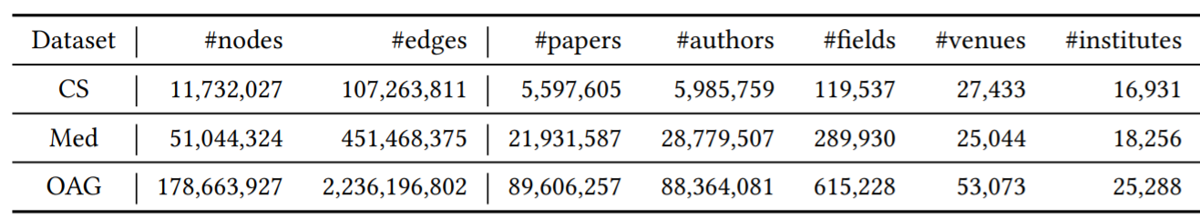
Evaluation on Open Academic Graph (OAG)
We evaluate on OAG, the largest publicly available heterogeneous academic dataset.
We propose an efficient Heterogeneous Mini-Batch Graph Sampling algorithm to enable both HGT and traditional GNNs handle Web-scale heterogeneous graph.

Slide 50
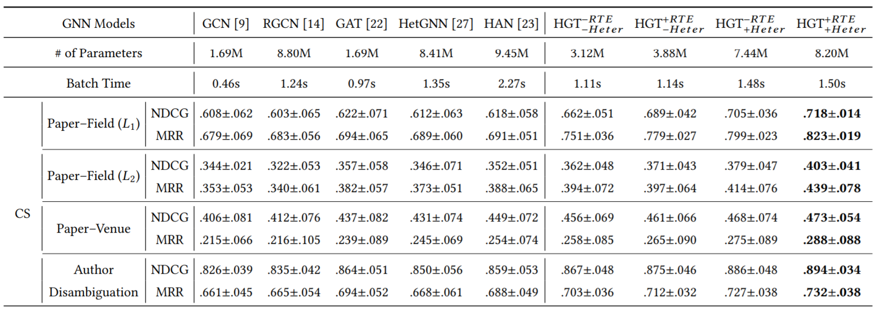
Evaluation Results
The proposed HGT model consistently outperforms all the state-of-the-art GNN baselines by 9%–21% on various downstream tasks.

Slide 51

HGT is currently ranked 1-st on Stanford OGBN-MAG leaderboard, achieves best performance with fewer parameter.

Slide 52
HGT is currently ranked 1-st on Stanford OGBN-MAG leaderboard, achieves best performance with fewer parameter.
It is deployed as backbone model for Microsoft Academic Graph, and deployed for Microsoft Office Graph’s anomaly detection service, outperforming previous system for about 10% Hit@1.

Slide 53

Case Study
DB + Networking + IR
DM + Networking + IR + DB
Conferences’ topics changed over time.
The relative temporal encoding can help capture this temporal evolution.

Slide 54
Case Study
DB + DM
ML + DB + Web + AI + NLP!!!
Conferences’ topics changed over time.
The relative temporal encoding can help capture this temporal evolution.

Slide 55
Case Study
CV + ML + AI
ML + CV + DL + NLP
Conferences’ topics changed over time.
The relative temporal encoding can help capture this temporal evolution.

Slide 56

Case Studies
HGT can implicitly extract meta paths for specific downstream tasks, without manual customization.

Slide 57
Contribution of Heterogeneous Graph Transformer
To handle graph heterogeneity
We use meta-relation-triplet to parametrize weights
Model can automatically detect useful meta paths without manual design
To handle graph dynamics and large-scale
We design Relative Temporal Encoding to represent dynamic graph
To handle large-scale graph
We design Heterogeneous Mini-Batch Graph Sampling algorithm to conduct efficient training on billion-scale heterogeneous graph

Slide 58

Thanks for Listening
The code and dataset is available at: https://github.com/acbull/pyHGT

Slide 59
Outline
Introduction to Heterogeneous Graph (HG)
Traditional HG Inference: Metapaths
Designing Graph Neural Networks for HG
Pre-Training Graph Neural Networks for HG

Slide 60


Generative Pre-Training of Graph Neural Networks
Ziniu Hu¹, Yuxiao Dong², Kuansan Wang², Kai-Wei Chang¹, Yizhou Sun¹
¹University of California, Los Angeles
²Microsoft Research, Redmond
Notes:
Hello everyone, my name is Ziniu Hu, a Ph.D. student from UCLA. I’m going to share our work: “Generative pre-training of Graph Neural Networks”
This is a joint work with Yuxiao Dong, Kuansan Wang From Microsoft Research Redmond, and Prof. Kai-Wei Chang and Yizhou Sun from UCLA.

Slide 61


Learning from Unlabeled Data
Labeled Data
Expensive, Scarce
Unlabeled Data
Accessible, Abundant (1000 X more)
Notes:
The success of machine learning is largely relied on data. However, high-quality labeled data is often expensive to obtain, or scarce for training large model. On the contrary, unlabeled data is much easier to access in a large amount, which can be thousand times more than labeled data.

Slide 62

Unsupervised Pre-Training
w/ Abundant
Unlabeled Data
w/ Few
Labeled Data
Notes:
A standard paradigm for learning from unlabeled data is a unsupervised pre-training. Its goal is to allow a machine learning model to initialize its parameters learned from pre-training tasks with abundant unlabeled data. As there exist commonality between the pre-training and the downstream tasks, the pre-trained knowledge can help the model generalize well even with few labeled data.

Slide 63


Unsupervised Pre-Training in NLP and CV
Recent progress of pre-training in NLP and CV shows that we can train very deep models (Transformer, ResNet) with unlabeled data to learn generic knowledge.
Yinhan Liu et al. RoBERTa: A Robustly Optimized BERT Pretraining Approach
Ting Chen et al. A Simple Framework for Contrastive Learning of Visual Representations
Notes:
Pre-training has shown superior in boosting the performance of many applications in natural language processing and computer vision.
In NLP domain, the huge success of BERT and its variant has shown that the task to reconstruct the masked input language can help learn very deep transformer model.
Also, in CV domain, recent work like SimCLR has shown to pre-train ResNet with contrastive task, which is detecting whether two image snippet comes from the same image,

Slide 64



Unsupervised Pre-Training in NLP and CV
Recent progress of pre-training in NLP and CV shows that we can train very deep models (Transformer, ResNet) with unlabeled data to learn generic knowledge.
The deep pre-trained model can be applied and benefit various downstream tasks with few labeled data.
Leaderboard of Squard 2.0
SimCLR results on ImageNet
Notes:
In both domains, the pre-trained deep model can serve as a backbone model and significantly improve the performance of various downstream tasks, such as question answering, image recognition. These success showed that unlabeled data itself contain rich semantic knowledge, and thus a model that can well capture the data distribution is able to benefit for downstream tasks.

Slide 65

Can we pre-train GNN on graphs?
GPT-GNN: Generative Pretraining of Graph Neural Networks:
Pre-train from large-scale attributed graphs
Fine-tune for unseen tasks on the graphs of the similar domain.
Pre-training task: reconstruct both the structure and attributes of the graphs.
Notes:
Inspired by these developments, we propose to pre-train graph neural networks.
The goal of the pre-training is to empower GNNs to capture the intrinsic structural and semantic properties of the graph, so that it can easily generalize to any downstream tasks with few labels.
In this work, we specifically focus on large-scale attributed graphs.

Slide 66


Pre-Training GNN via Generation
Model the graph distribution by learning to reconstruct the attributed graph.
Apple’s Internal Innovation Network
Notes:
To learn a general GNN model without labeled data on a graph, the first question is: how to design a suitable unsupervised learning task over the graph?
We propose to Model the graph distribution by directly learning to reconstruct the attributed graph. For example, if we can correctly predict how a Apple’s innovation network is evolved, the pre-trained model should capture the structural and semantic knowledge of this graph, which will be beneficial to related downstream tasks.

Slide 67

Pre-Training GNN via Generation
Model the graph distribution by learning to reconstruct the attributed graph.
Notes:
Following the existing discrete generation methods, we autoregressively factorize the probability objective, which means that, the nodes in the graph come in an order, and the links are generated by connecting the new arriving nodes to all existing nodes.

Slide 68
Pre-Training GNN via Generation
Model the graph distribution by learning to reconstruct the attributed graph.
We factorize the conditional generative probability of each node into two terms:
Attribute (X_{i}) Generation
Edge (E_{i}) Generation
Lose the dependency between X_{i} and E_{i}
Notes:
As we’d like to capture both attribute and structure information, we need to factorize the conditional generative probability for each node into two terms, the attribute and edge generation.
However, a naïve decomposition will neglect the dependency between each node’s attribute with its own edges, which is very essential for GNN modelling.

Slide 69
Factorizing Attributed Graph Generation
To maintain the dependency between attribute and structure, we incorporate observed edges, and decompose the generation into two coupled steps:
Given observed edges, generate node attributes;
Given observed edges and generated attributes, generate masked edges.
Notes:
Therefore, to maintain the dependency between attribute and structure, we incorporate a variable to represent observed edges, and decompose the generation into two coupled steps.
In the first step, we are given a set of observed edges, and generate node attributes,
In the second step, we leverage the attribute information to generate remaining edges.
We present a concrete example in academic

Slide 70
Factorizing Attributed Graph Generation
To maintain the dependency between attribute and structure, we incorporate observed edges, and decompose the generation into two coupled steps:
Given observed edges, generate node attributes;
Given observed edges and generated attributes, generate masked edges.
Author 1
Published at 2012
DM
Paper 1
……
……
KDD
Author 2
Input
Notes:
present a concrete example in academic graph here.
Suppose we’d like to generate a new paper node, whose title is considered as attribute, and authors, venue, cited papers are connected edges.

Slide 71
Factorizing Attributed Graph Generation
To maintain the dependency between attribute and structure, we incorporate observed edges, and decompose the generation into two coupled steps:
Given observed edges, generate node attributes;
Given observed edges and generated attributes, generate masked edges.
Author 1
Published at 2012
DM
Paper 1
……
……
KDD
Author 2
Input
Notes:
We first mask out some edges, and regard the remaining ones as observed edges.

Slide 72
Factorizing Attributed Graph Generation
To maintain the dependency between attribute and structure, we incorporate observed edges, and decompose the generation into two coupled steps:
Given observed edges, generate node attributes;
Given observed edges and generated attributes, generate masked edges.
Author 1
Published at 2012
DM
Paper 1
……
……
1: Generate Node Attribute
KDD
Author 2
Input
Notes:
The first step is to use the remaining edges to predict this paper’s title, which can help capture the dependency between the attribute and neighborhood nodes, such as Data Mining.

Slide 73
Factorizing Attributed Graph Generation
To maintain the dependency between attribute and structure, we incorporate observed edges, and decompose the generation into two coupled steps:
Given observed edges, generate node attributes;
Given observed edges and generated attributes, generate masked edges.
2: Generate masked edges
Author 1
Published at 2012
DM
Paper 1
2: Generate masked edges
……
……
KDD
Author 2
Input
Notes:
Next, we use both the observed edge and generated attribute to predict the remaining edges, such as authors, published venue, citations. In this way, we can also capture the dependency between attribute and masked edges, such as KDD.

Slide 74

Factorizing Attributed Graph Generation
Model the graph distribution by learning to reconstruct the attributed graph.
We factorize the graph likelihood into two terms:
Attribute Generation
Edge Generation
Notes:
Formally, we can write down the decomposition. With random masking of the edges, the expectation of our generation task is equivalent to the whole graph distribution.

Slide 75
Efficient Parallel Training
We desire to parallelize the generation for all the nodes, by running GNN only once for each graph.
However, Edge Generation requires attribute, which will leak to Attribute Generation.
Notes:
For the sake of efficiency, we desire to compute the loss of attribute and edge generations by running GNN only once for each graph.
However, when doing edge generation, we will utilize the attribute information, which will leak to the attribute generation task.

Slide 76

Efficient Parallel Training
We desire to parallelize the generation for all the nodes, by running GNN only once for each graph.
However, Edge Generation requires attribute, which will leak to Attribute Generation.
Our solution: we split each node into two types: Attribute Generation Nodes and Edge Generation Nodes. For Attribute Generation Nodes, input are replaced by a shared [Mask] token.
Notes:
To avoid information leakage, we split each node into two types of nodes: •
Attribute Generation Nodes. We masked out the attributes of these nodes and replace them with a dummy token and learned a shared vector to represent it† .
Edge Generation Nodes. For these nodes, we keep their attributes and put them as input.
After running GNN over the graph, we’ll get the two sets of node representation of each node, which will be used for the two generation tasks.

Slide 77

Deal with large-scale Graphs
To pre-train GNNs on graphs that are too large to fit into the hardware, we adopt LADIES sampling algorithm¹ for mini-batch training.
However, to estimate the contrastive loss it’s required to go over all nodes.
To enrich the negative samples, we adopt Adaptive Queue, which stores previously calculated node representations, which can enlarge the negative sample size.
Difan Zou et al. Layer-Dependent Importance Sampling for Training Deep and Large Graph Convolutional Networks, NeurIPS’19
Notes:
To pre-train GNNs on graphs that are too large to fit into the hardware, we sample subgraphs for training.
To estimate the edge loss, it is required to go over all nodes of the input graph as denominator. However, we only have access to the sampled nodes in a subgraph for estimating this loss, making the (self-)supervision only focus on local signals.
To alleviate this issue, we propose the Adaptive Queue, which stores node representations in previously-sampled subgraphs as negative samples, which can enlarge the negative sample size

Slide 78


Evaluation Datasets
We choose two large-scale heterogeneous graphs as evaluation:
Microsoft Open Academic Graph (OAG)
Amazon Review Recommendation (Amazon)
82.8 million reviews
20.9 million users
9.3 million products.
Notes:
To evaluate the performance of GPT-GNN, we conduct experiments on two large-scale heterogenous graphs.
The first one is Microsoft Academic Graph (OAG), which contains more than 200 million nodes and 2.3 billion edges. The other is Amazon Recommendation datasets.

Slide 79

Evaluation Datasets
Ziniu Hu et al. Heterogeneous Graph Transformer, WWW’20
Notes:
Here we focus on the discussion of Open Academic Graph Datasets.
The fine-tuning task is inferring the topic and venue of each paper and author name disambiguation. We mainly utilize Heterogenous Graph Transformer as our base model.

Slide 80

Evaluation Datasets
Notes:
To mimic real-world domain transfer setting, we choose nodes of some specific domains for pre-training, and conduct downstream evaluation to a different domain.
Specifically, in Field Transfer, we use all the papers except CS for pre-training, and use CS papers for fine-tuning. In Time Transfer, we use CS paper before 2014 for pre-training, and CS papers after 2014 for fine-tuning.
We also consider combine the two transfer together, which becomes the most challenging setting.

Slide 81


Notes:
Overall, our proposed GPT-GNN consistently enhances the downstream task performance and outperforms other baselines under different settings, and it achieves performance gain of 9.1%.
The two generation tasks are all helpful, and the combined version is the best pre-training task.

Slide 82

The Promise of Generative Pre-training
Notes:
We also evaluate the promise of our proposed pre-training method under different percentage of labelled data. As is shown, GPT-GNN consistently improve the downstream task performance.
In addition, we can see that with-pre-training, the performance with only 20% label data is higher than direct supervised learning with 100% data. This shows the effectiveness of pre-training, especially when the label is scarce.

Slide 83

The Promise of Generative Pre-training
Notes:
We also show the loss curve with and without pre-training. With pre-training, the model can achieve higher generalization performance and more robust to over-fitting.

Slide 84

The Promise of Generative Pre-training
Notes:
Also, we show the generated title in our pre-training task. It seems that the model can indeed capture the overall semantic of each paper only utilize their neighborhood.

Slide 85

The Promise of Generative Pre-training
GPT-GNN can consistently improve performance for various GNN models.
A more expressive GNN model (as HGT) can receive higher performance gain.
Notes:
We also show that GPT-GNN can consistently improve the performance for various GNN models, but a more expressive model as HGT can receive higher performance gain.

Slide 86

The Promise of Generative Pre-training
GPT-GNN can consistently improve performance for various GNN models.
A more expressive GNN model (as HGT) can receive higher performance gain.
GPT-GNN can also be utilized for homogeneous graphs and get the highest performance gain.
Notes:
Finally, we show that GPT-GNN can be utilized for homogenous graphs and get the highest performance gain.

Slide 87

Thanks for listening!
Code and Dataset are available:

